Slide 1
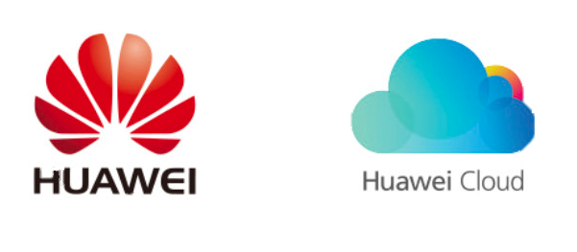
Distant Supervision for Multi-stage Fine-tuning in Retrieval-based Question Answering
*Yuqing Xie^{1,2}, *Wei Yang^{1,2}, Luchen Tan², Kun Xiong², Nicholas Jing Yuan³, Baoxing Huai³, Ming Li^{1,2}, Jimmy Lin²
¹David R. Cheriton School Of Computer Science, University Of Waterloo, ²RSVP.AI, ³Huawei Cloud & AI
*Equal contribution
Notes:
Hi everyone, my name is Yuqing Xie. I am really happy to be here and welcome to our presentation.
We work on the Open domain question answering task, based on a retrieval and reader architecture.
We present a data augmentation technique to automatically annotate paragraphs to supplement existing training data.
We explored exploit negative samples augmentation for retrieval based QA and explored on several critical factors in training on augmented data.

Slide 2
Contributions
Automatically labelling negative training examples.
Integrating existing labeled datasets with distantly supervised datasets.
Exploring critical details:
Sample quality / quantity
Negative / positive sample ratio
Fine-tune order

Slide 3
Model: IR + MRC for Open-QA
Problem:
1. Only 442 docs: repeated paragraphs
2. No negative training data
End-to-End Open-Domain Question Answering with BERTserini. Yang. W. et al (NAACL 2019)
Notes:
QpenQA is the task that given a knowledge related question, the system have to return the answer based on a large corpus, such as Wikipedia.
Our previous work BERTserini first uses a BM25 retrieval to get the top n related paragraphs
[Click]
Then feed these paragraphs into a BERT-based reader to extract the answer spans. The BERT model is trained the SQuAD 1.1 dataset.
This system yields a large improvement over previous non-BERT based models.
We follow this architecture.
However, tuning BERT only on the original datasets can’t take advantage of the large corpus and will face the following problems.
[Click]
First, SQuAD only contains 400 articles, with repeated paragraphs for different questions. These context are too tedious compared with context during inference, which is Wikipedia.
[Click]
Secondly, the dataset doesn’t contain negative samples, which appears frequently during retrieval.

Slide 4
Motivation
Golden
Positive Sample
No answer! → Negative Sample
Notes:
To better illustrate this, let’s look at what actually happen during retrieval
Say we have the query: where did super bowl 50 take place?
The retriever will return 3 possible kinds of paragraphs
[Click]
First, the golden paragraphs, just as in the Source dataset.
Second, paragraphs in which correct answer appear, but not a paragraph in the source dataset, we call them positive samples.
Say we have a model trained only on SQuAD, during inference, it will miss the answer because it haven't see such context.
[Click]
The third kind of paragraphs are those in which correct answer don’t appear, we call them negative samples
The model also can't predict no answer. because the training set didn’t tell it how to deal with negative paragraphs.
How to solve this? Let’s train the model on these cases.

Slide 5
Method
1~3*SRC
5~9*SRC
 | SQuAD(en ) | TriviaQA(en) | CMRC(zh) | DRCD(zh)
SRC Train | 88k | 88k | 10k | 27k
SRC Test | 11k | 11k | 3k | 4k
DS Pos (+) | 64k | 264k | 9k | 42k
DS All (±) | 447k | 789k | 69k | 247k
Notes:
Here we propose our data augmentation method.
For each sample in the source dataset, we retrieve top related passages just as in inference time.
[Click]
We label them as positive or negative samples.
[Click]
And we can add them to the finetuning data.
[Click]
Other than the source dataset, now we can create the Distant supervised datasets:
DS pos contains only positive samples, while DS all contains all kinds of samples.
We do experiments on two English datasets SQuAD and TriviaQA and two Chinese QA datasets CMRC and DRCD.
After augmentation, we acquire around 1-3 times positive samples as many as golden samples but with they have more diverse paragraphs.
Negative samples are 4-7 times as many as golden samples. this distribution is similar as in real retrieval.

Slide 6
Results
 | SQuAD | TriviaQA | CMRC | DRCD
 | Exact Match | Exact Match | Exact Match | Exact Match
SRC | 41.8 | 51.0 | 44.5 | 50.7
DS(+) | 44.0 | 48.2 | 45.5 | 50.5
DS(±) | 48.7 | 54.4 | 48.3 | 53.2
SRC+DS(±) | 45.7 | 53.1 | 49.0 | 55.4
SRC→DS(±) | 51.2 (+9.4) | 53.7 (+2.7) | 49.2 (+4.7) | 54.4 (+3.7)
SOTA | GraphQA (wwm+large) 56.5 | WKLM + Ranking 58.1 | BERTserini+DS 49.2 | BERTserini+DS 55.4
Best Finetune order:
First Source (Distant)
Then DS (Close)
Notes:
How can we make use of all these datasets?
Other than training BERT on these datasets separately ,
[Click]
we can also train on combined datasets.
We tried to mix them together and tune on them stage-wise.
[Click]
This table shows that first train on the source dataset and then train on the DS all dataset achieves the best result.
It makes sense not to mix qualitatively different datasets, but to fine-tune on them in the distant-to-close order.
Compared with model not trained on the DS data, we gain near 10 percent Exact match rate on squad.
We achieved a large gain compared with the stated of the art on all of the four datasets, when the paper was submitted.
Even now, we are still at or near the SOTA without any model improvement.
This data augmentation is orthogonal to model improvements, so it is broadly applicable and will remain relevant with future modeling advances.

Slide 7
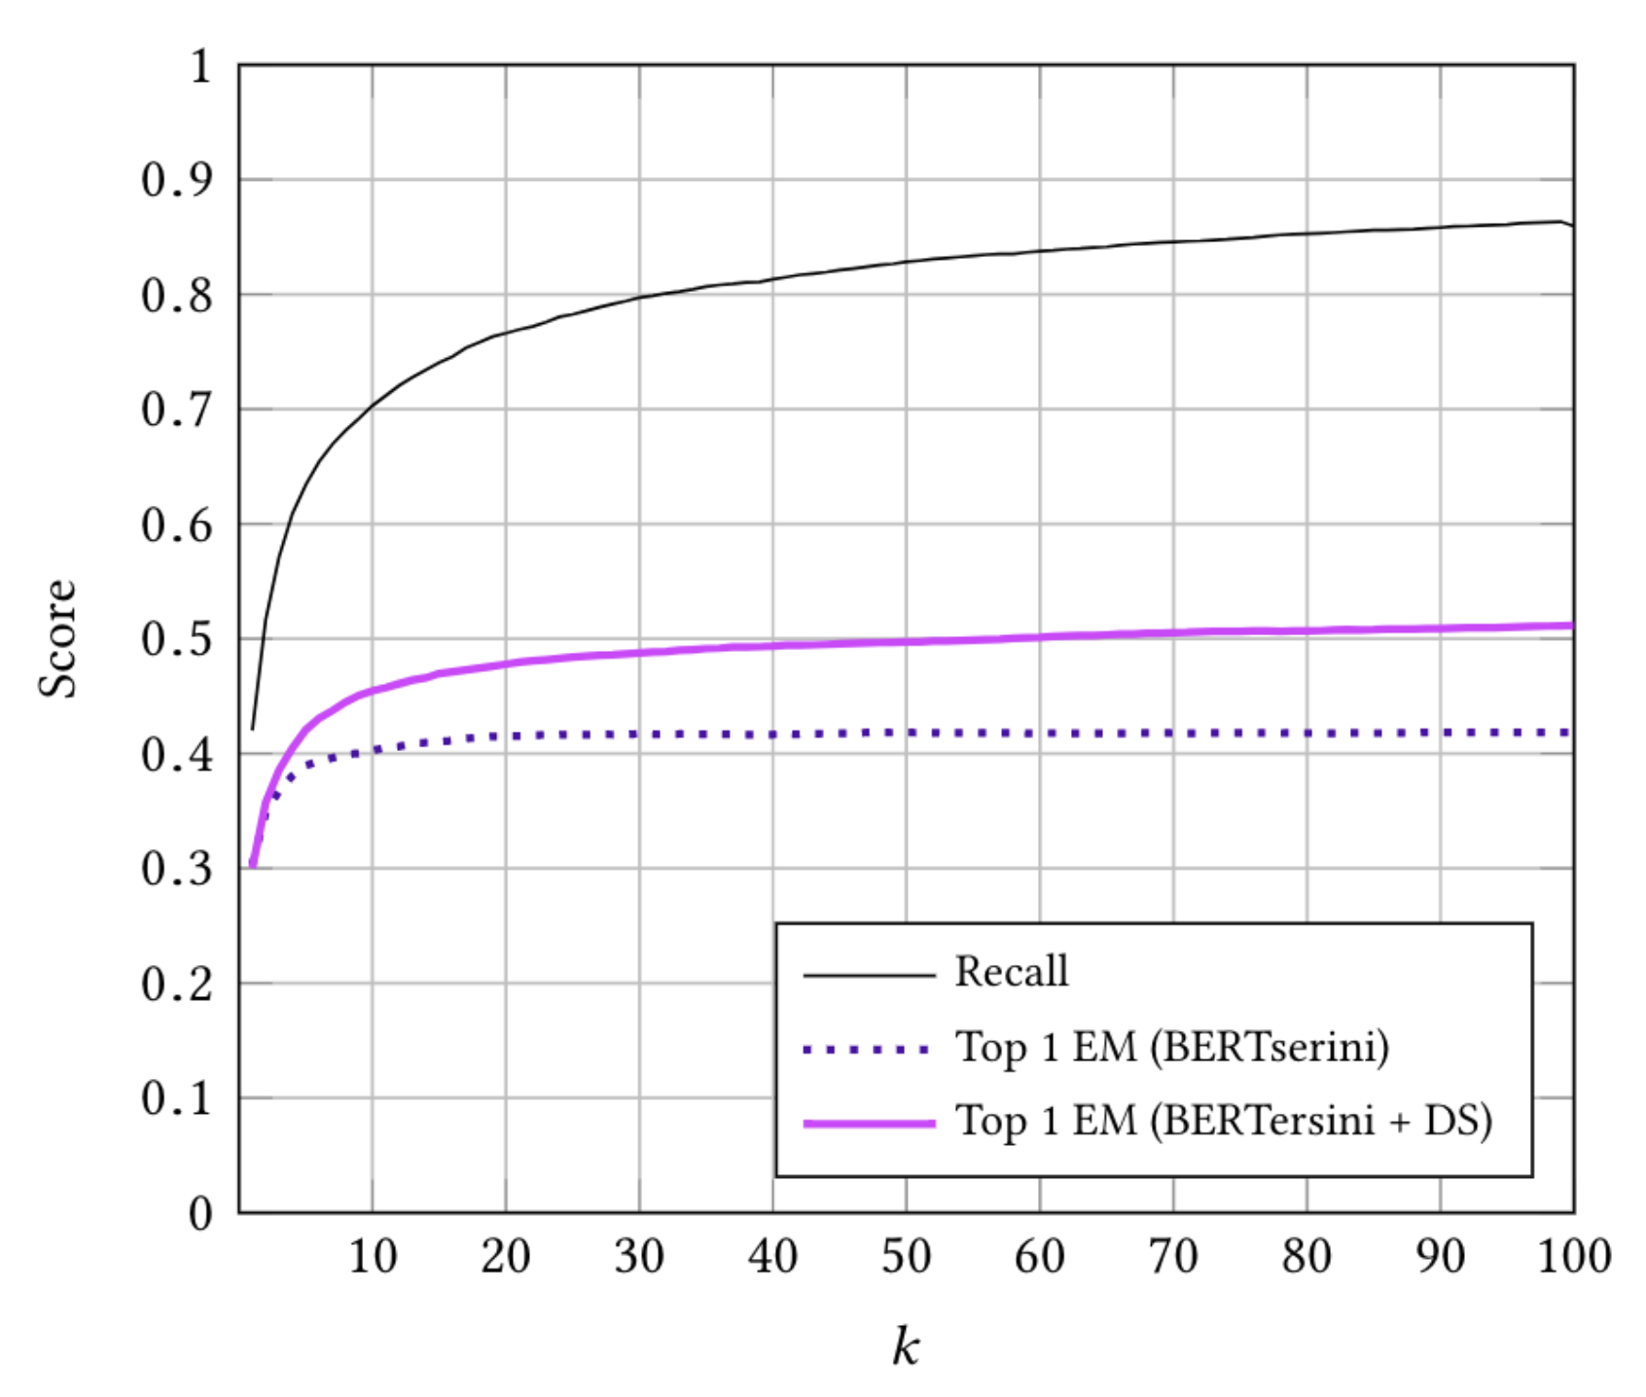
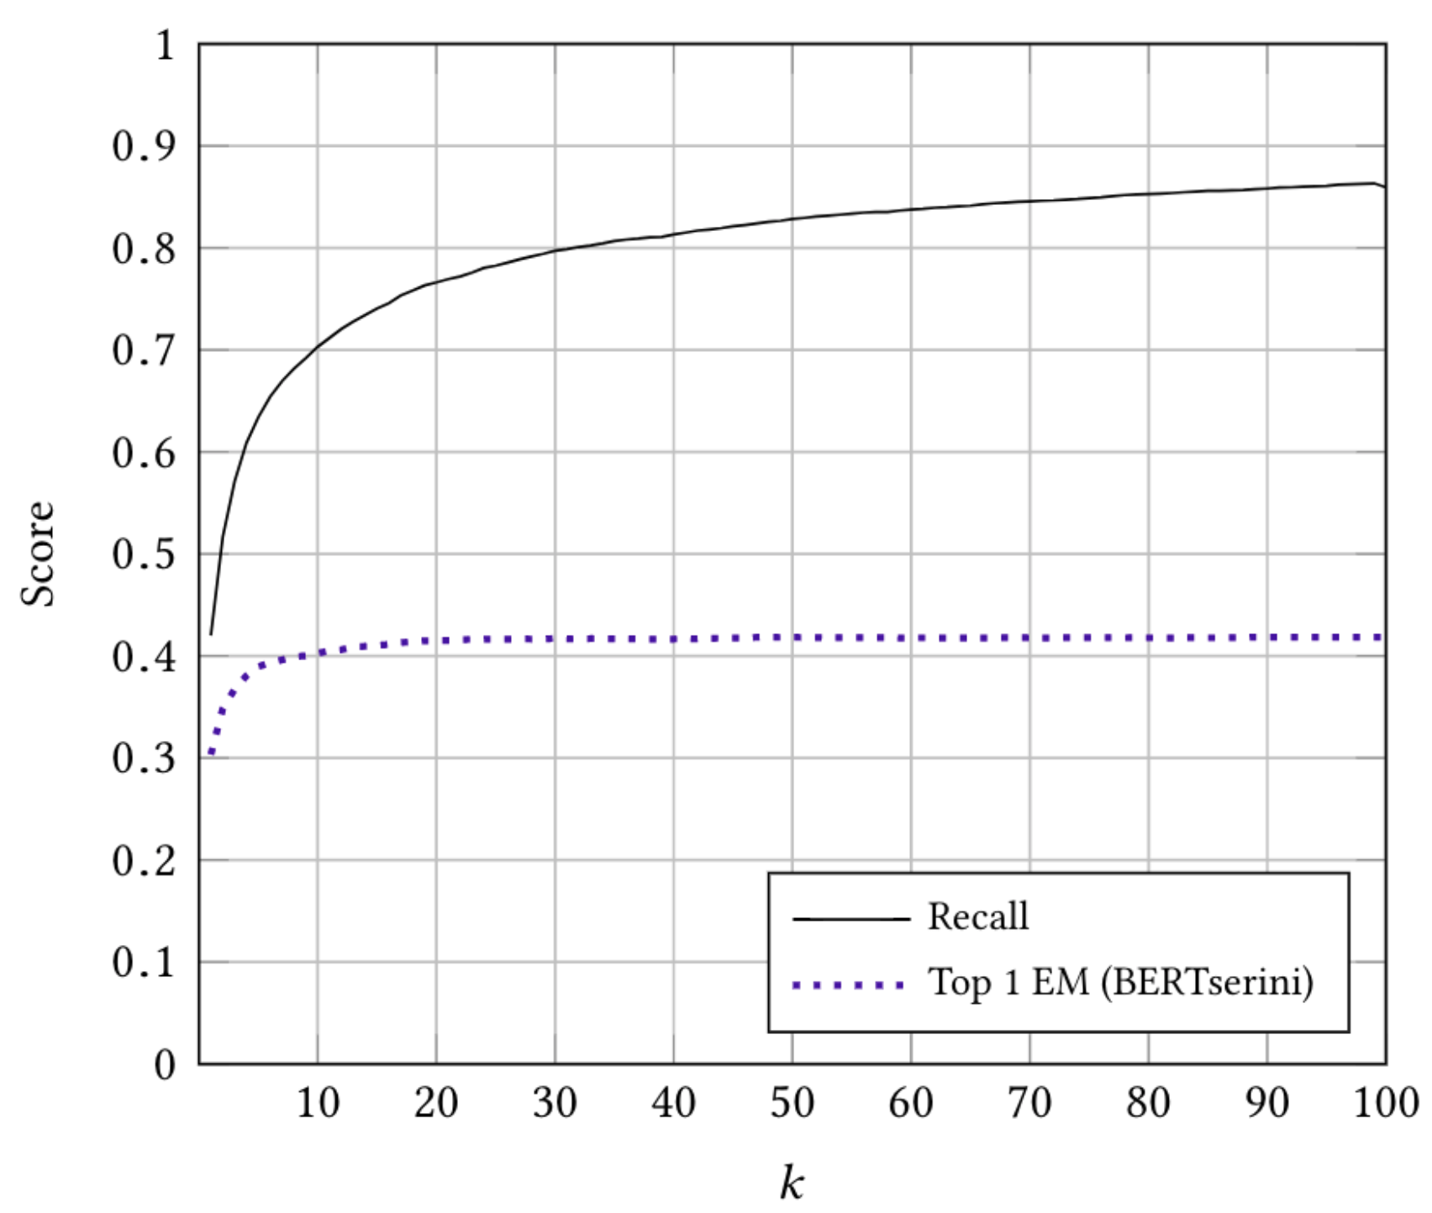
Samples Quantity and Quality
No!
Paragraph quality decreases
as n goes up.
Always better with more samples?
n Paragraphs Retrieved – experiment on SQuAD 1.1
Notes:
Now, let’s explore how the sample selection affect the results.
[Click]
We can acquire enough samples as long as we retrieve more paragraphs.
So, does it always help if we add more data this way?
[Click]
We plot the exact match rate as the sample number grows for each query.
The Exact match rate increases but tends to converge.
[Click]
The data augmentation helps to improve about 10 percent EM, but the performance still converges around n equals 30.
[Click]
This is because that the paragraphs are much less relevant to the query as n goes up.
To acquire a good sample quality, we limit the retriever returns at most top 30 paragraphs.

Slide 8
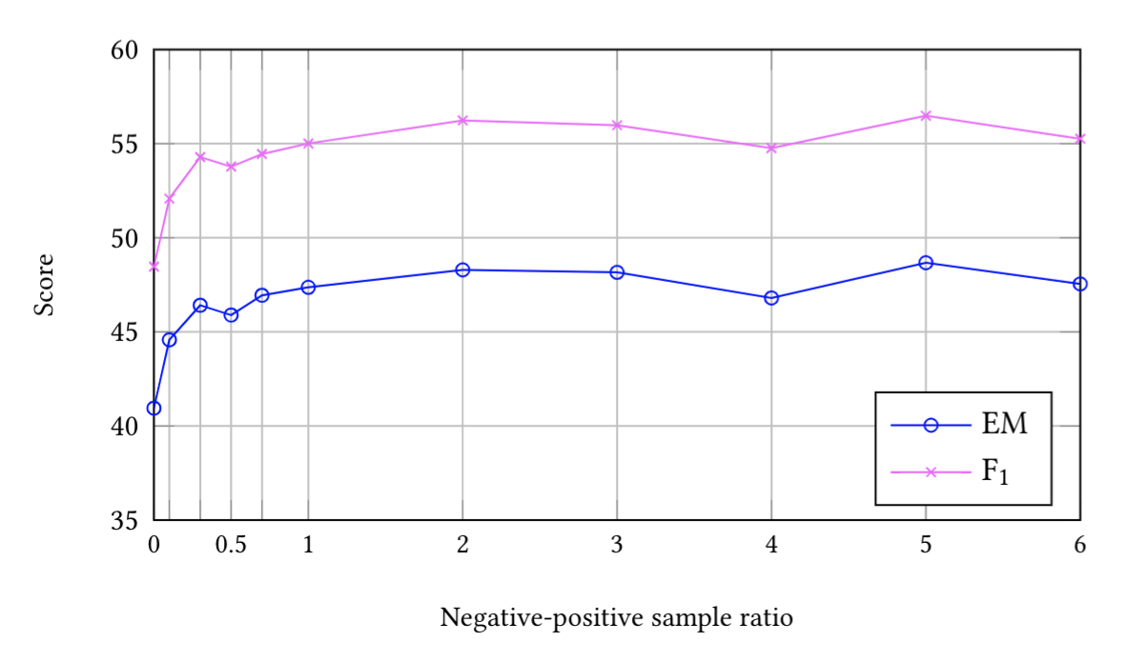
Positive/Negative sample ratio - ˠ
Small ˠ
Large ˠ
Yes!
Similar pos/neg sample ratio as in retrieval
works the best.
ˠ
Keep the positive/negative sample ratio as in retrieval?
Notes:
Next, how does the positive and negative sample ratio gamma affect?
For each query, we can control gamma by drop samples.
[Click]
We plot the accuracy as gamma goes from zero to six, which means from no negative samples, to one positive with six negative samples for each query.
Although there is are some noise, we can still see the exact match increases to the top at around the ratio 5,
[Click]
This is similar as in true data distribution.

Slide 9
Negative Sample order
✓
Top-down
 | SQuAD |  | CMRC
 | EM | F1 | EM | F1
Top-down | 49.2 | 57.2 | 48.8 | 64.5
Bottom-up | 46.8 | 54.9 | 48.6 | 65.2
Random | 49.6 | 57.6 | 48.6 | 64.7
Random
Bottom-up
Random is the best!
Best sampling order?
Notes:
Then, does the sample order also affect?
We sample the negative samples in three ways:
[Click]
from the top to the bottom, from the bottom to the top, or sample them randomly.
[Click]
Experiments shows it’s better to randomly sampling
[Click]
because this will include both commonly appearing samples and hard samples, which let the finetuning benefit the most.

Slide 10
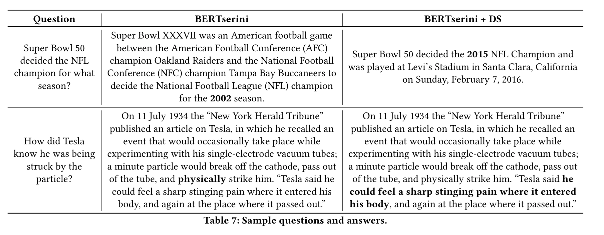
QA Result after DS
Train on DS helps to
learn diverse context
and
act on negative paragraphs
Notes:
Last, let’s see how the model improves after trained on the augmented data.
Here is a example in the development set from SQuAD. The model trained only on SQuAD learns to match patterns.
It find the pattern “for what season”, and marks the token in the position of wh word as the answer, "for the 2002 season"
Even the context is obviously incorrect.
But after trained on the distant supervised data, the model avoided this error
This is because the model is exposed to sufficiently diverse contexts.
This proves our augmentation method let the model learn more diverse contexts and avoid false prediction on negative paragraphs.

Slide 11
Conclusion
Automatically label negative training examples.
Use source data’s Q&A
Label as positive/negative paragraphs according to answer’s appearance
Integrating source & DS datasets.
Stage-wise finetuning
Explored critical details:
Sample quality / quantity : sample quality will drop as number goes up
Negative / positive sample ratio
Fine-tune order
Notes:
To sum up,
We propose a method to using existing datasets to identify negative training examples, which is less considered in the previous work.
We proved that retrieval-based systems will encounter many non-relevant passages, which makes augmenting only positive examples inadequate.
Another unexplored area in previous work is how to integrate existing training data with the distantly supervised data.
We showed that simply combining all the data may not be the best.
Instead, the distant to close stage-wise fine-tuning BERT works the best.
We also explore a number of details that are critical to achieving high accuracy for training BERT on augmented data.

Slide 12
Thank You!
Please feel free to contact me through yuqing.xie@uwaterloo.ca if you have any question.
Notes:
Thank you for your attention.
Now, I will open the floor for any question.

Slide 13
Reference
Wei Yang, Yuqing Xie, Aileen Lin, Xingyu Li, Luchen Tan, Kun Xiong, MingLi, and Jimmy Lin. 2019. End-to-End Open-Domain Question Answering with BERTserini. NAACL 2019
Pranav Rajpurkar, Jian Zhang, Konstantin Lopyrev, and Percy Liang. SQuAD: 100,000+ Questions for Machine Comprehension of Text. EMNLP 2016
Akari Asai , Kazuma Hashimoto, Hannaneh Hajishirzi, Richard Socher, and Caiming Xiong. Learning to Retrieve Reasoning Paths over Wikipedia Graph for Question Answering. ICLR 2020
Wenhan Xiong , Jingfei Du , William Yang Wang , Veselin Stoyanov , Pretrained Encyclopedia: Weakly Supervised Knowledge-pretrained Language Model. ICLR 2020

Slide 14
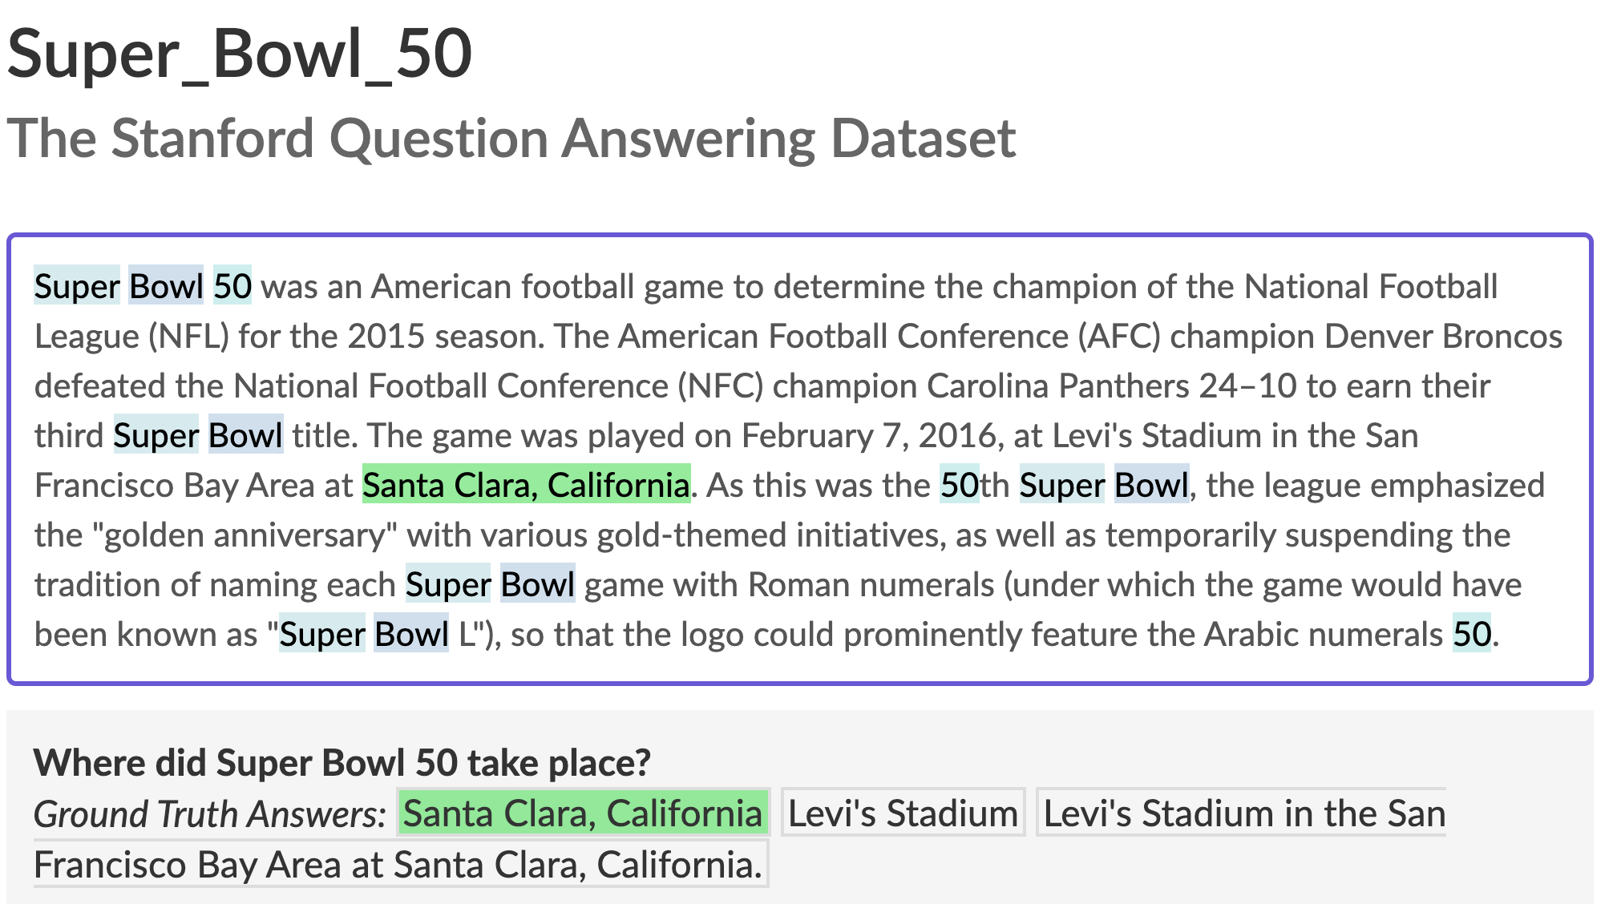
Negative samples
Super Bowl commercials . The popularity of video sharing websites such as YouTube have also allowed Super Bowl advertisements to become viral videos; to take advantage of this, a growing number of advertisers have elected to post previews of their commercial, or even the full-length commercial, online prior to the game. A notable example of this strategy occurred at Super Bowl XLV: on February 2, 2011, four days prior to the game, Volkswagen posted the full version of its "Star Wars"-themed ad "The Force" on YouTube. By Sunday, the ad had already received over 16 million views, and went on to be the most shared Super Bowl advertisement ever. Ironically, until Super Bowl 50, official online streams of the Super Bowl provided by U.S. broadcasters did not include all of the commercials from the television broadcast; at Super Bowl XLIX, only 18 advertisers bought ad time within NBC's stream of the game (although NBC did post all of the ads on a Tumblr blog throughout the game). At Super Bowl 50, CBS mandated that each advertiser buy a package of advertising time on both the television and digital broadcasts, meaning that for the first time, the online stream of Super Bowl 50 provided by CBS included all national commercials from the television broadcast.
Positive sample
Super Bowl 50 halftime show . The Super Bowl 50 halftime show took place on February 7, 2016, at Levi's Stadium in Santa Clara, California as part of Super Bowl 50. It was headlined by the British rock group Coldplay with special guest performers Beyoncé and Bruno Mars, who headlined the Super Bowl XLVII and Super Bowl XLVIII halftime shows, respectively.
SQuAD: 100,000+ Questions for Machine Comprehension of Text (Rajpurkar. P. et al. EMNLP 2016)

Slide 15
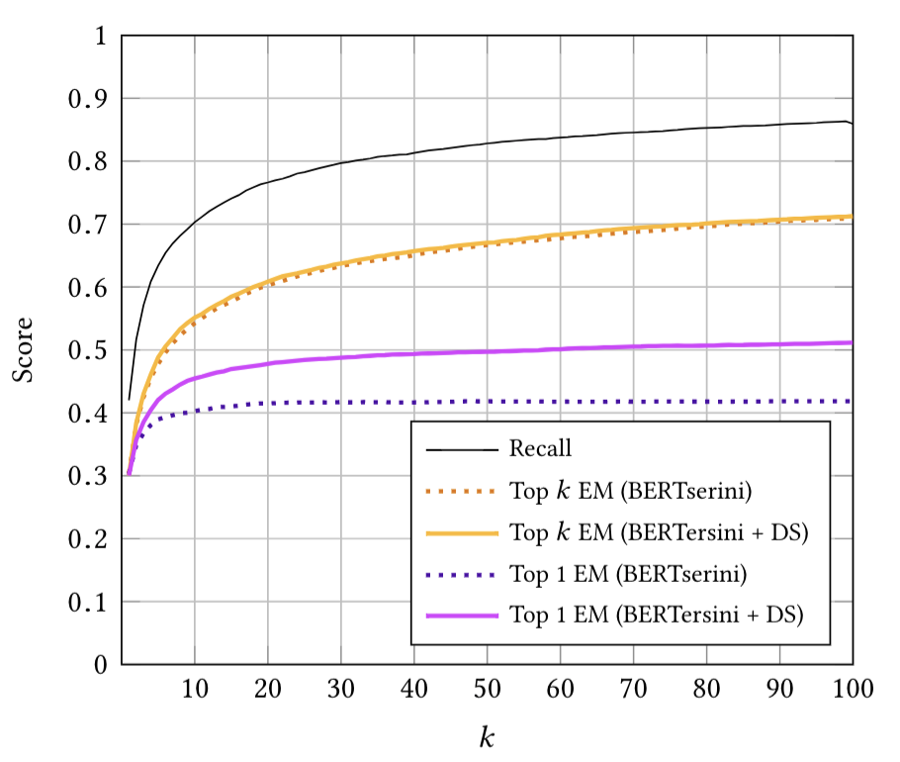
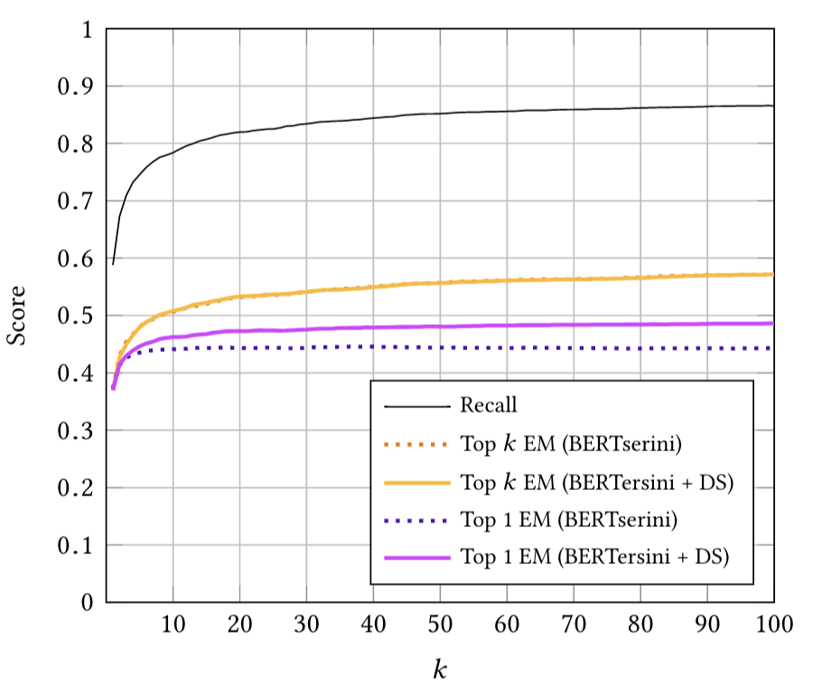
Figure 2: Effects Of The Number Of Retrieved Paragraphs k on SQuAD (Left) And CMRC (Right).

Slide 16
